Slide 1


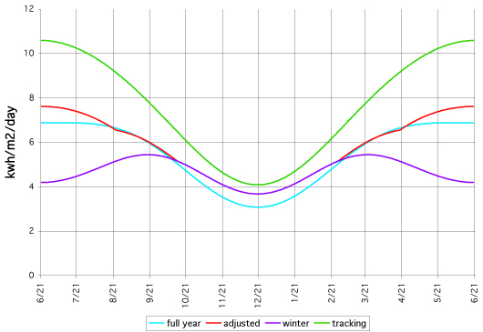
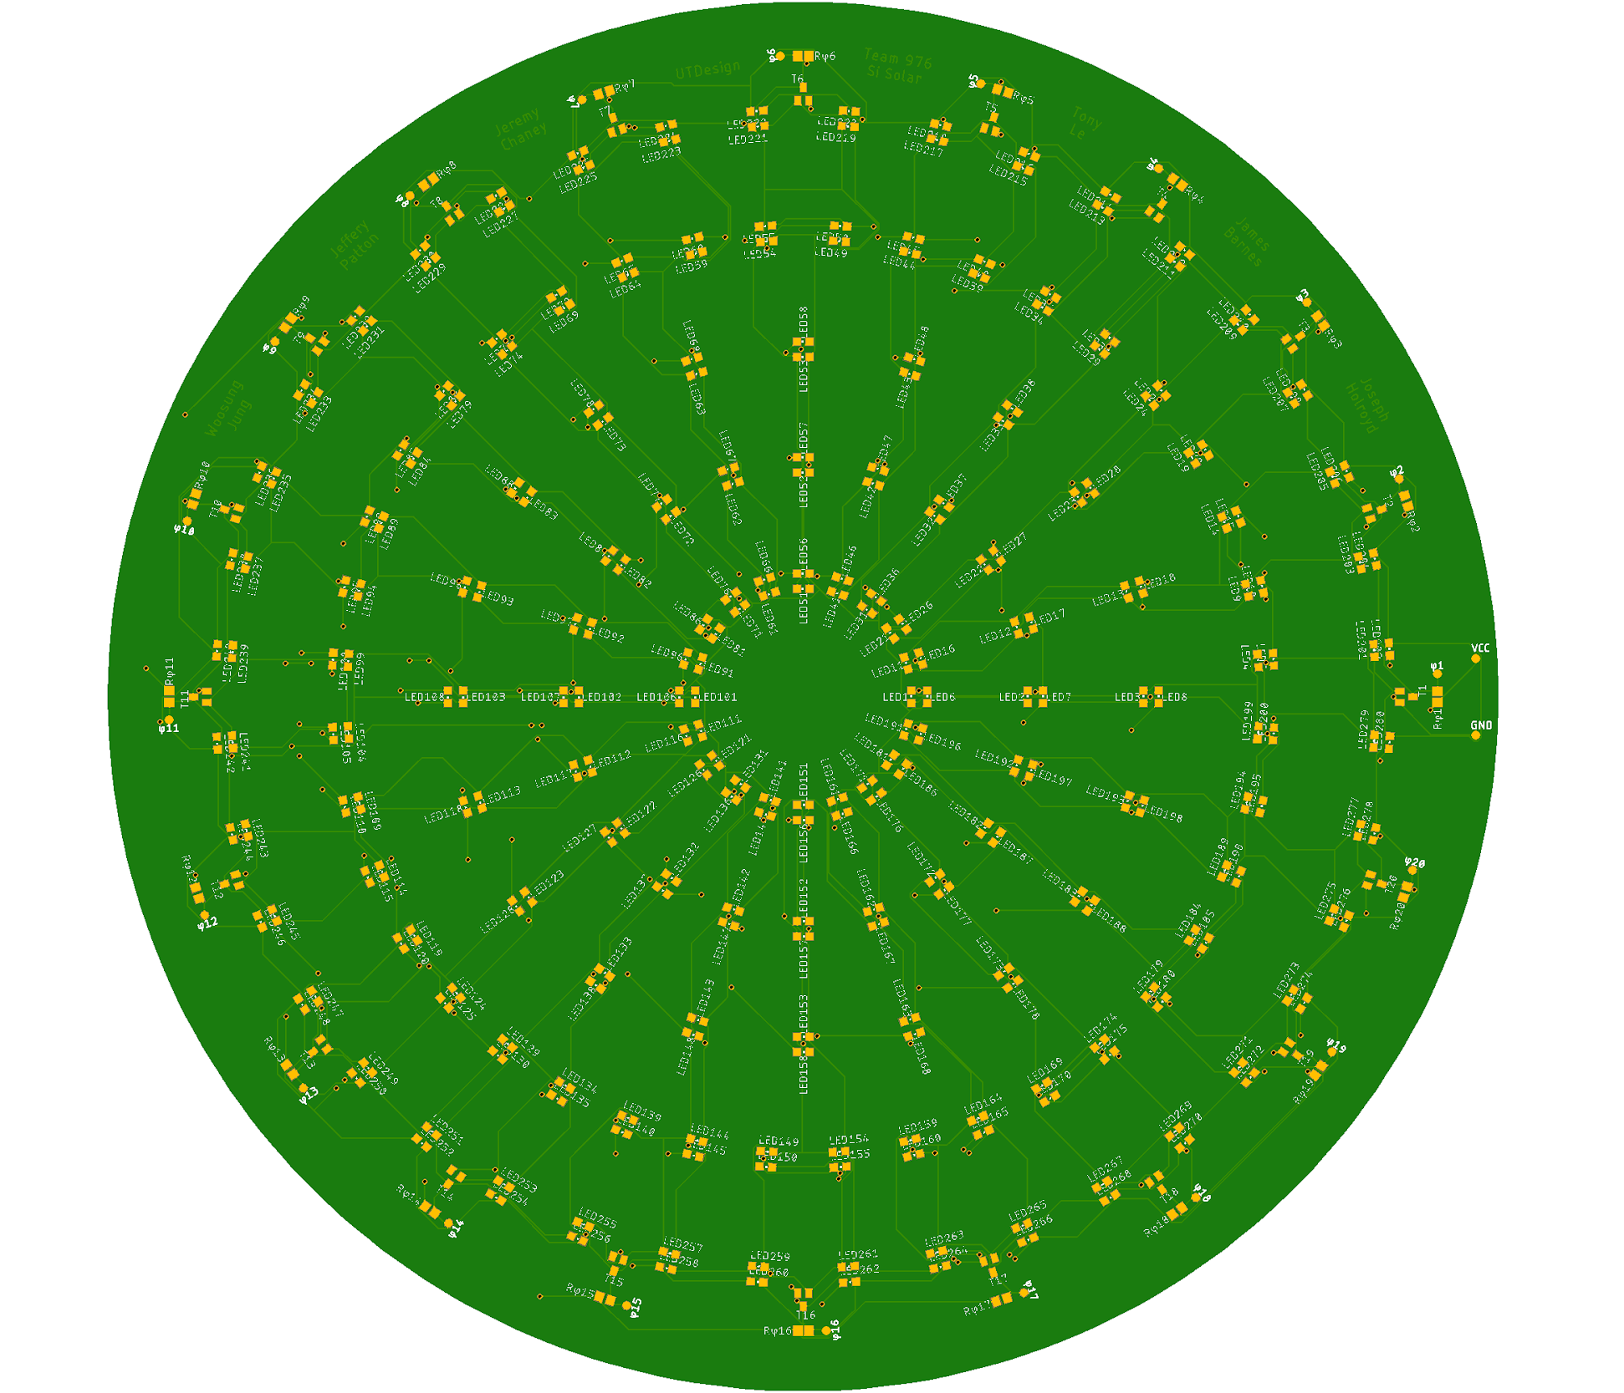
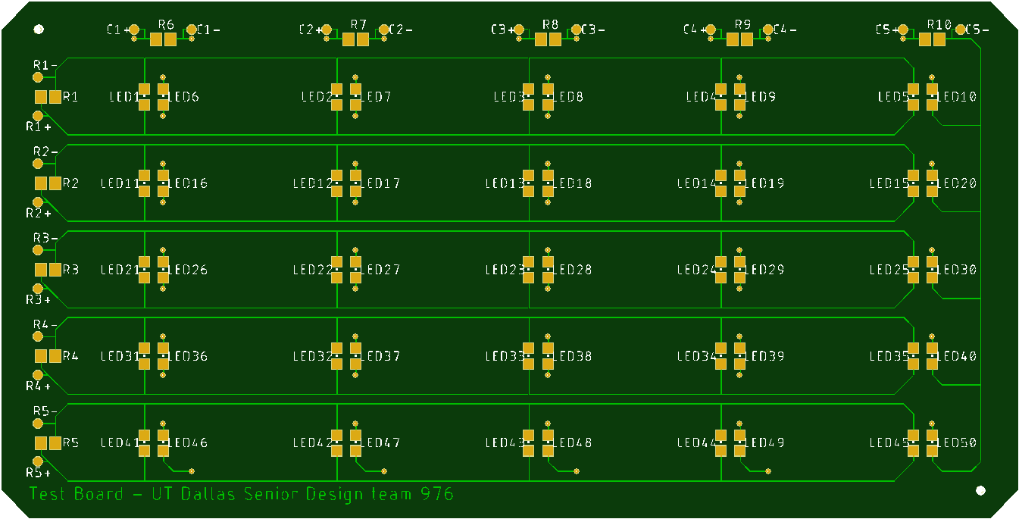
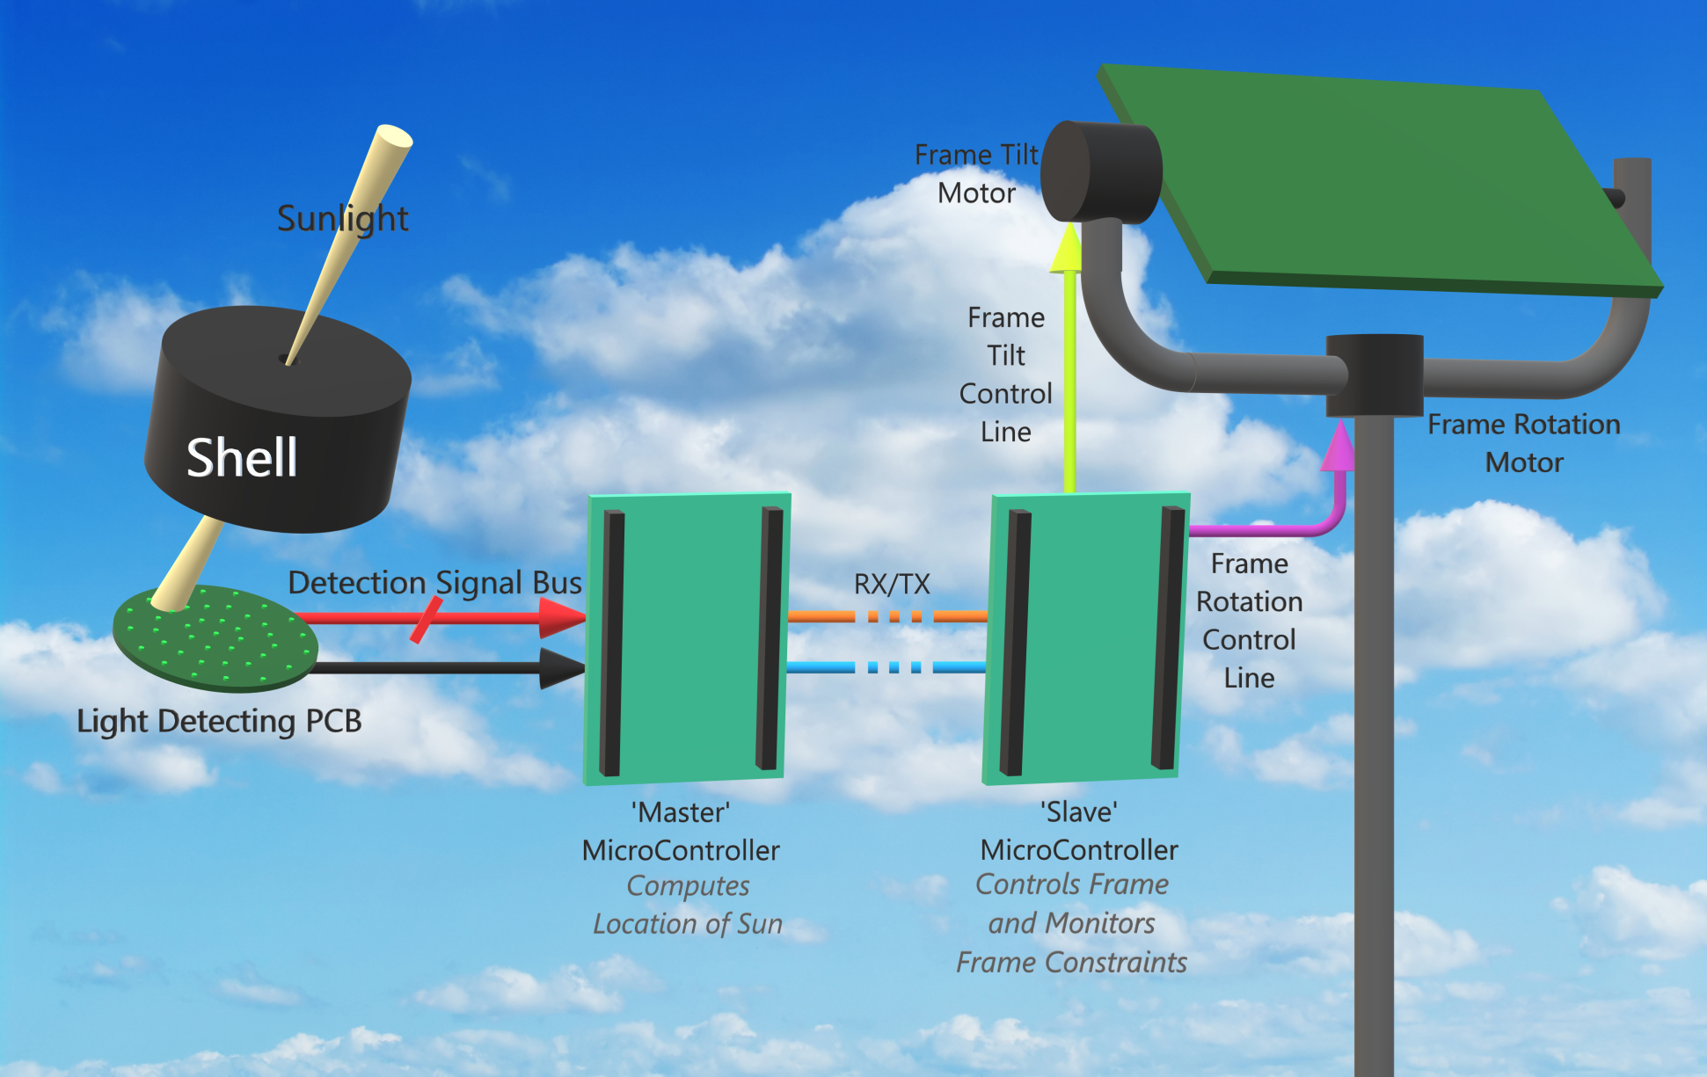
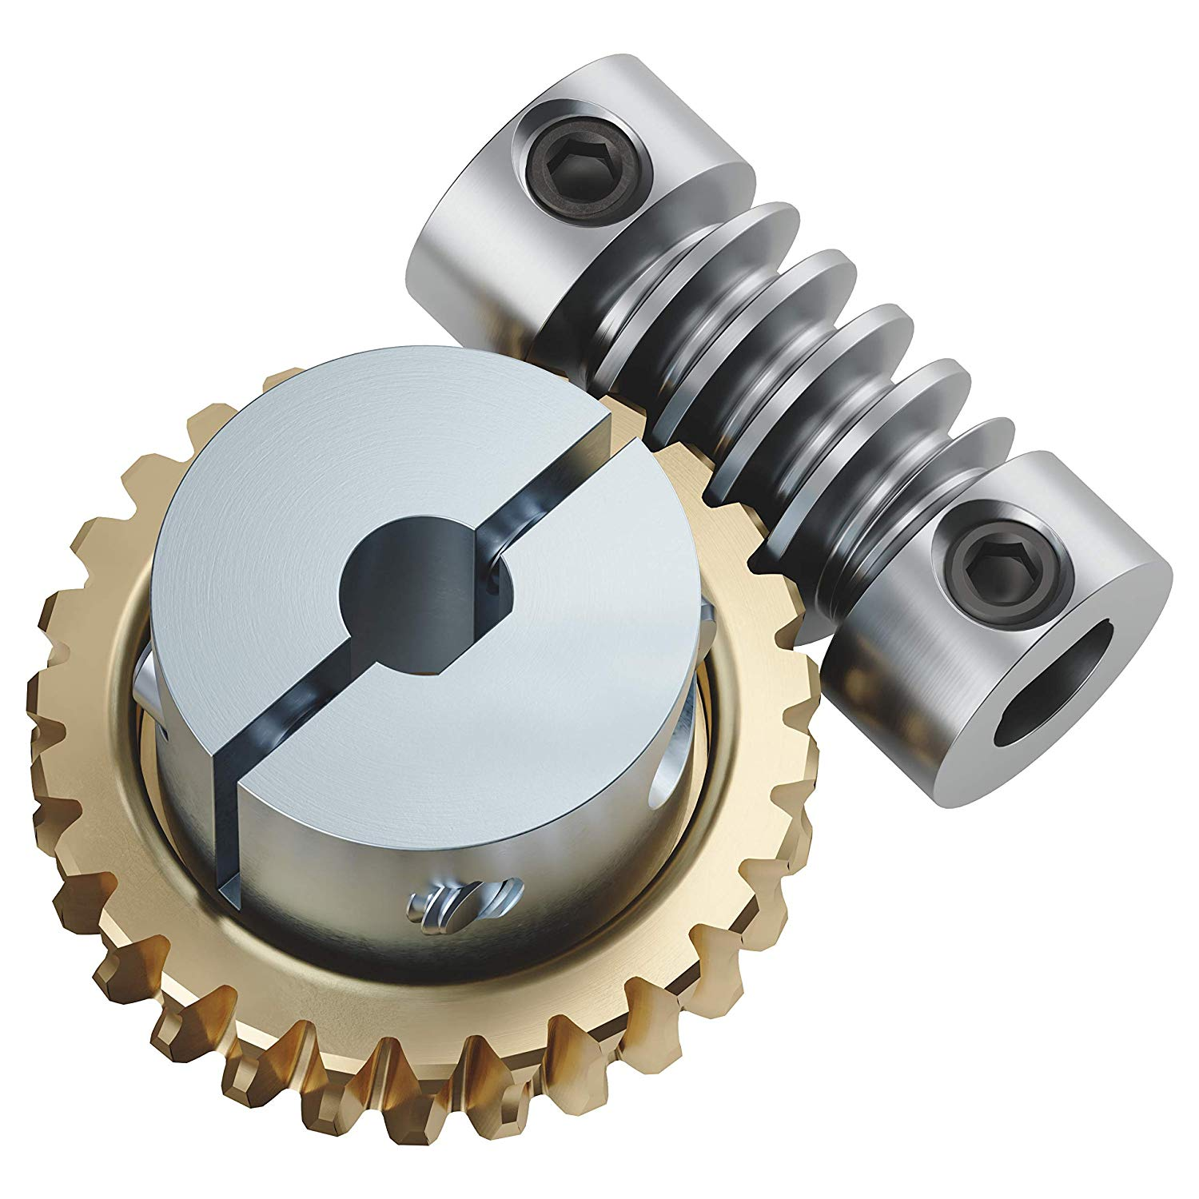
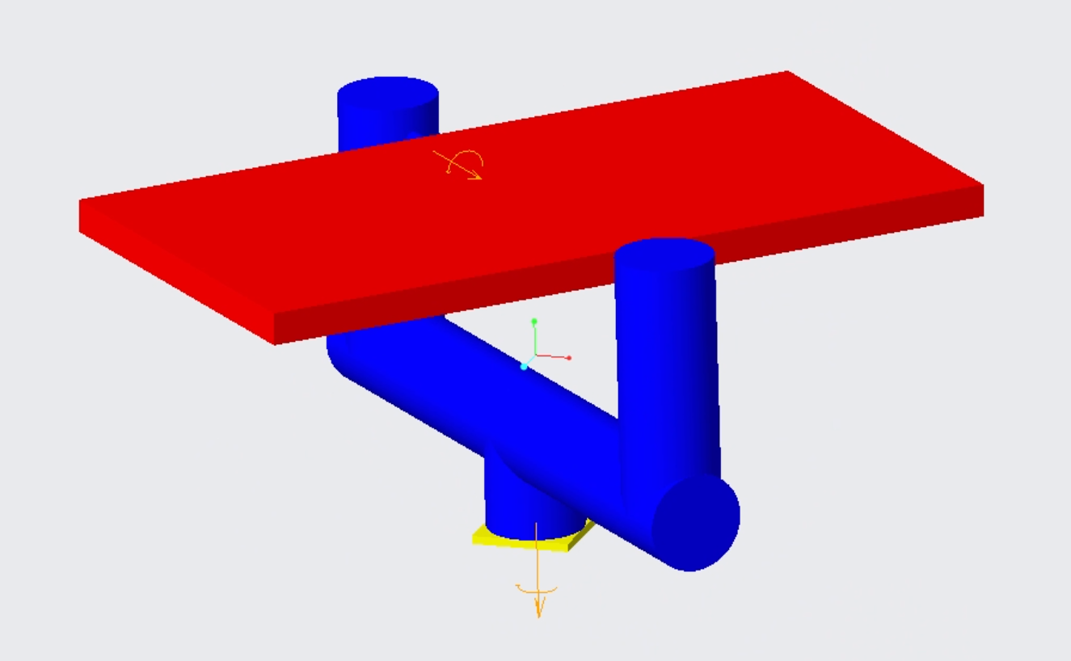
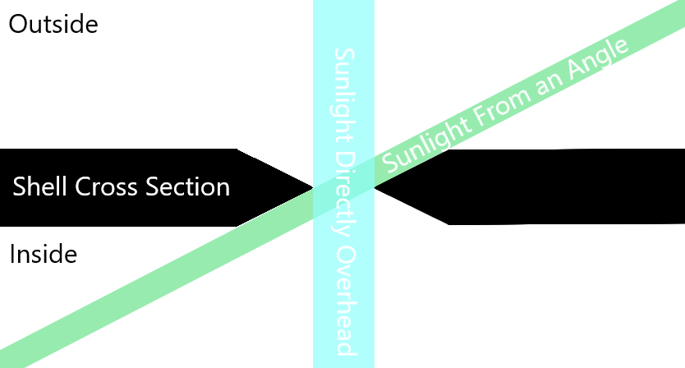
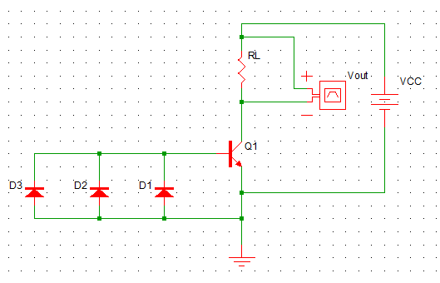
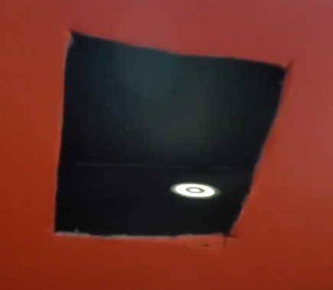
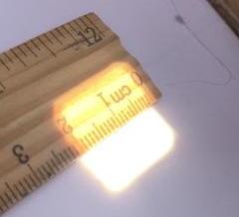
Solar Angle Detector and Orienting Solar Panel
Erik Jonsson School of Engineering & Computer Science
The University of Texas at Dallas
UTDesign I: Fall 2019
Mentor: Dr. Neal Skinner
Tony Le (CE), Woosung Jung (EE), Jeremy Chaney (EE), Joseph Holroyd (EE), James Barnes (EE), Jeffrey Patton (EE)
txl173330@utdallas.edu, wxj170630@utdallas.edu, Jeremy.Chaney@utdallas.edu, jxh162530@utdallas.edu, James@utdallas.edu, jdp150130@utdallas.edu
Background
Objectives & Goals
Problems & Solutions
Solar panels are recorded to yield higher power outputs when pointed directly towards the sun or otherwise "tracking".
To capture more solar energy along with making the device portable and easy to use for the average consumer.
To develop an easy, accessible, and automated solar panel device for a user with minimal prior experience and includes increased output power yield from the sun due to its sun tracking capabilities.
Finding electronic components sensitive to light:
Looking into various components including LEDs, Photoresistors, and UV Index Scanners.
Decided on LEDs, cheapest and most reliable.
Due to nature of problem, a spherical approach is taken for the PCB design
Designing a 2-Axis Solar Panel Mount:
Finding a solution for allowing efficient rotation, simplistic design, and wind resistance.
Utilizing a worm gear train for high torque and consequently great wind resistance.
Landau, Charles. “Optimum Tilt of Solar Panels.” Optimum Tilt of Solar Panels, 18 Mar. 2017, http://solarpaneltilt.com/.
PCB Design
System Overview & Process
Prototype Board:
Component Test Board:
System
Overview
Solar Panel
Solar Control
We use the ‘Close-Loop System’ for the target position to the actual position.
Feedback for controlling the rotational or linear speed and position.
Feedback is from encoder.
Motors / Frame
Big Battery
Accelerometer
µController
Small Battery
Dimensions of diode placement (mm).
Pinhole diameter of 20mm and putting bisecting LEDs on rows four and five of the angle (+80 LEDs).
Sensor
Dome µController
Accelerometer
Target
Position
+
Controller
Motor
Gear
Actual
Position
_
At least 1 “node” will always receive sunlight. (max distance between nodes is under 20mm)
Feedback
Pictorial Model
Frame Design
Design of the Sensor
Worm Gear
High Torque, smaller motors are able to rotate our solar panel.
Wind will not cause the solar panel to spin.
2-Axis Mount
Rotation at the base.
Tilt control at the top of one of the posts.
Signal Amplifiers
To increase the ΔV due to sunlight, the CE amplifier shown is used.
Future Goals
Results
Decide which bearing we will use for holding the axis pipes.
improve mechanical design
MUX readings, which will reduce needed inputs for a microcontroller.
Build our own model and test it in three or four different places in five to six weeks.
Tested the path of the sun light passing the pin hole using the shoebox.
Tested the pinhole size.
2cm hole will be good adequate.
Organization
Tony Le: Scribe Woosung Jung: Team Leader
Jeremy Chaney: PCB/Circuit Design Joseph Holroyd: Frame Design
James Barnes: Shell Design Jeffrey Patton: PCB Design
Special Thanks To
Dr. Neal Skinner and UTDesign Faculty and Staff

